Slide 1

Competitive Programming From Problem 2 Solution in O(1)
P
T
H
I
N
K
F
A
S
T
S
C++ Data Types and Variables -2
Mostafa Saad Ibrahim
Teaching Assistant @ Cairo University

Slide 2
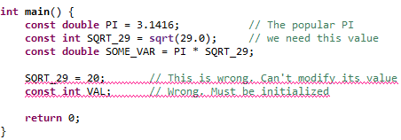
Const qualifier
Sometimes we need to define a variable such that once it is initialized, it can’t be changed.
We use const qualifier to do so.
Typically const variables are written UPPER case

Slide 3
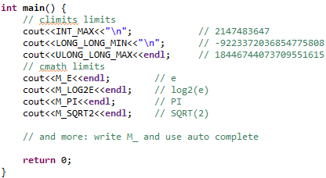
Built in Constants

Slide 4
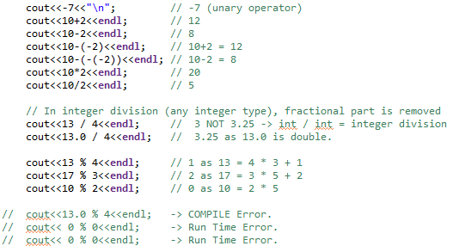
Arithmetic Operators

Slide 5
Operations and Types Conversion
C++ Operators works only on same type
If different types, some values are promoted
If type is short or char, promoted directly to int
In the given order, if one type exist, all promoted to it:
long double, double, float, unsigned long long, long long, unsigned int, int

Slide 6
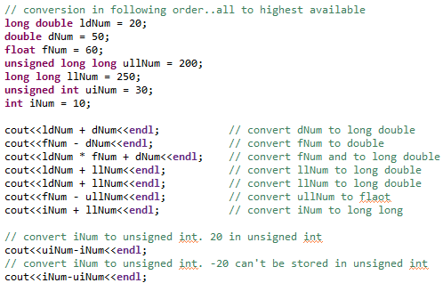
Operations and Types Conversion

Slide 7
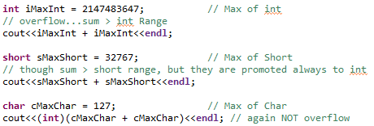
Short/Char Types Conversion

Slide 8
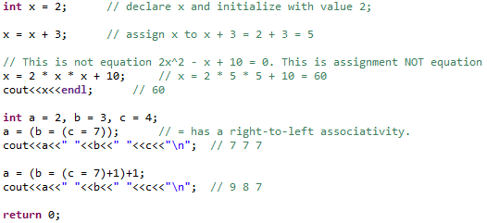
Assignment Operator

Slide 9
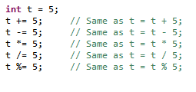
Shortcut Assignment Operator

Slide 10
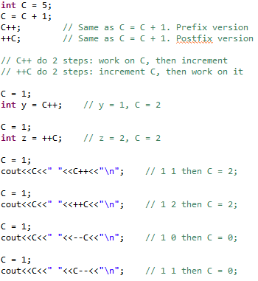
Increment/Decrement Operators

Slide 11
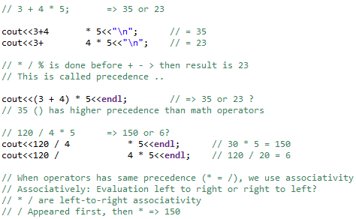
Operator Precedence and Associativity

Slide 12
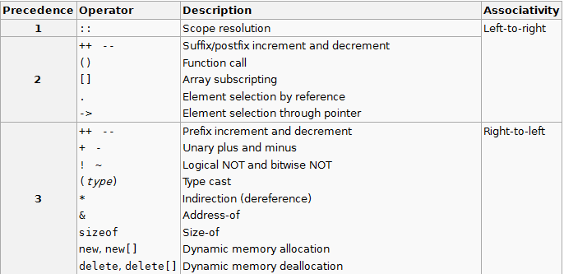
Precedence Table - 1

Slide 13
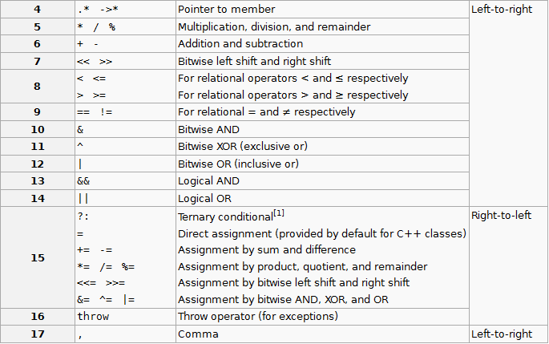
Precedence Table - 2

Slide 14
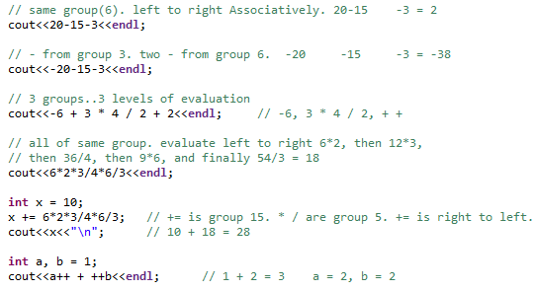
Operator Precedence and Associativity Examples

Slide 15
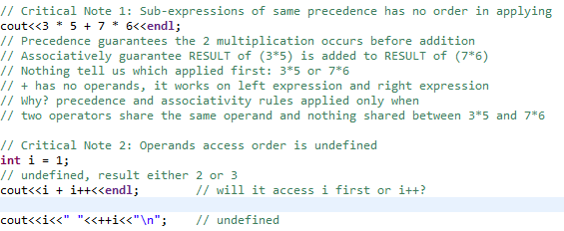
Operator Precedence and Associativity: Notes

Slide 16
Variables Scope
Scope = Where the variable is seen?
Variable visibility
Starts with its declaration
End with the end of its enclosing curly braces }
What if used variable outside its scope?
Compile error. Variable not defined.
Define a variable close to where you need it

Slide 17
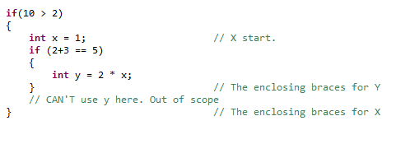
Scope Example
Nested scope
X scope

Slide 18
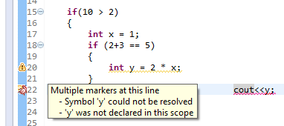
Compile Error for Scope
Bug = error

Slide 19
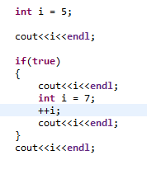
Tricky scope
5
5
Avoid such code
8
5

Slide 20

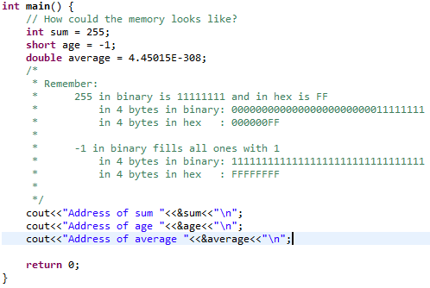
Variables and Memory

Slide 21
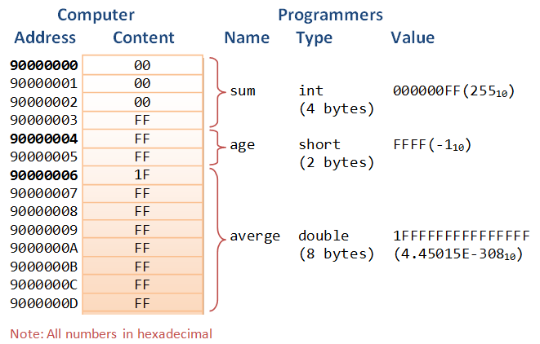
Variables and Memory Snapshot
Variable sum in
Memory location
90000000
Img src: http://www3.ntu.edu.sg/home/ehchua/programming/cpp/images/MemoryAddressContent.png

Slide 22
Practice: Parse Memory
Assume memory is as following
000000010000000000000000000000000000011001000001
Assume memory as following is: bool, integer, character
What are their values?
Bool is 8 bits
Integer is 32 bits
Character is 8 bits
00000001 = 1 => boolean value true
00000000000000000000000000000110 => integer 6
01000001 = 65 => Value of character A

Slide 23

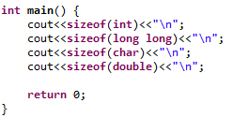
Size of My Machine Types

Slide 24
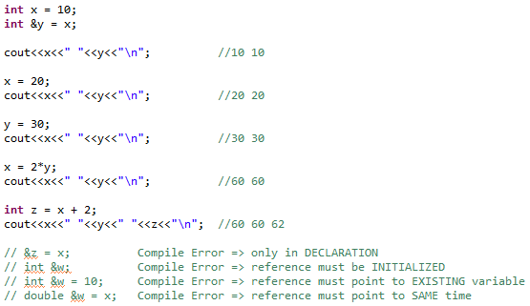
Reference
Another name for an already existing variable.

